Slide 1
High Value Care Collaborative
August 2018

Slide 2



Notes:
The relationship between hospitals and physicians has never been more important. That’s why AHA has launched the Physician Alliance – a place for physician and administrative leadership to transform health care together. The Alliance provides new resources, services and experiences on a range of issues, including clinician well-being, leadership models and health improvement, developed specifically for busy physicians within AHA-member organizations.
The Alliance’s work is framed by three fundamental values that foster shared decision-making and forge a common language among all health care leaders – Lead Well. Be Well. Care Well.
Lead Well focuses on improving the health of the enterprise and developing collaborative teams to move organizations forward.
Be Well is about improving the health of clinicians.
Care Well prioritizes better health for patients and communities.
AHA Members can sign up for exclusive content at aha.org/physicians to start receiving resources, and access to training opportunities available only to Alliance members.

Slide 3

AGENDA
Welcome
Overview
  Curriculum
  Mentors
Co-sponsors:
  Costs of Care
  ABIM Foundation (Choosing Wisely)
High-Value Care Culture Survey

Slide 4

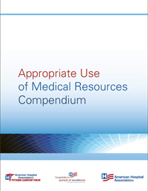
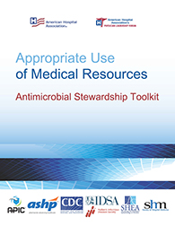
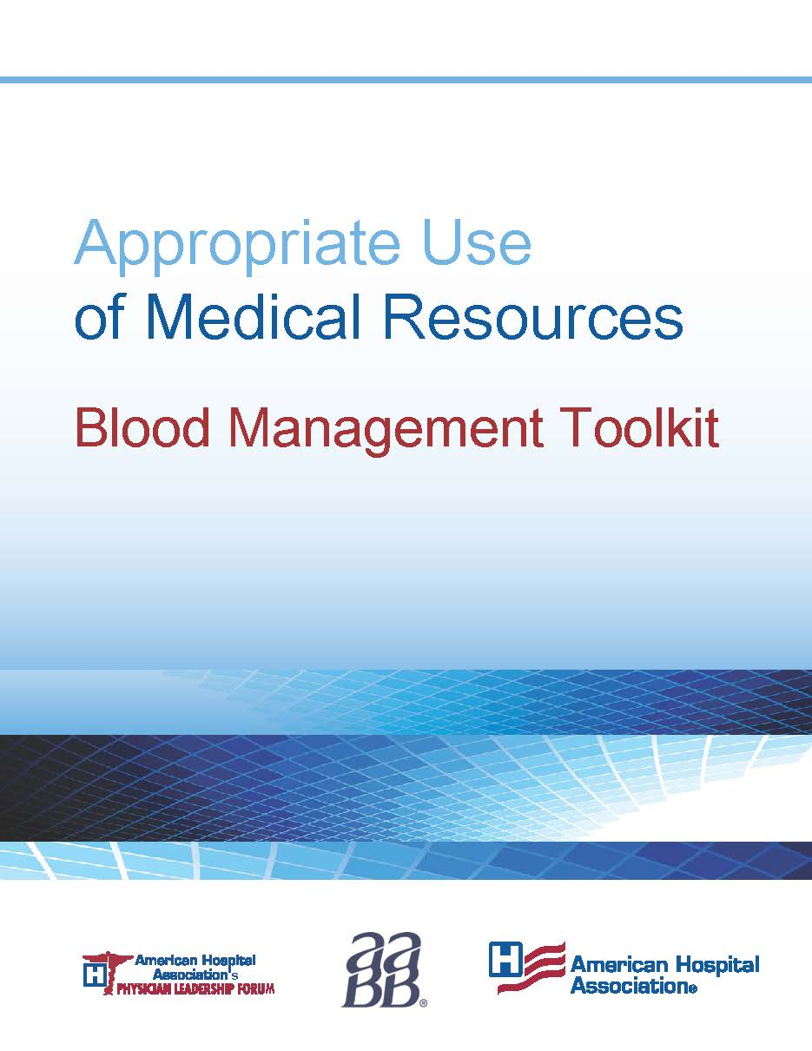
High-Value Care Collaborative
Website of resources https://www.aha.org/high-value-care-resources
How it works
Webinar schedule https://www.aha.org/high-value-care-webinars
Team support

Slide 5
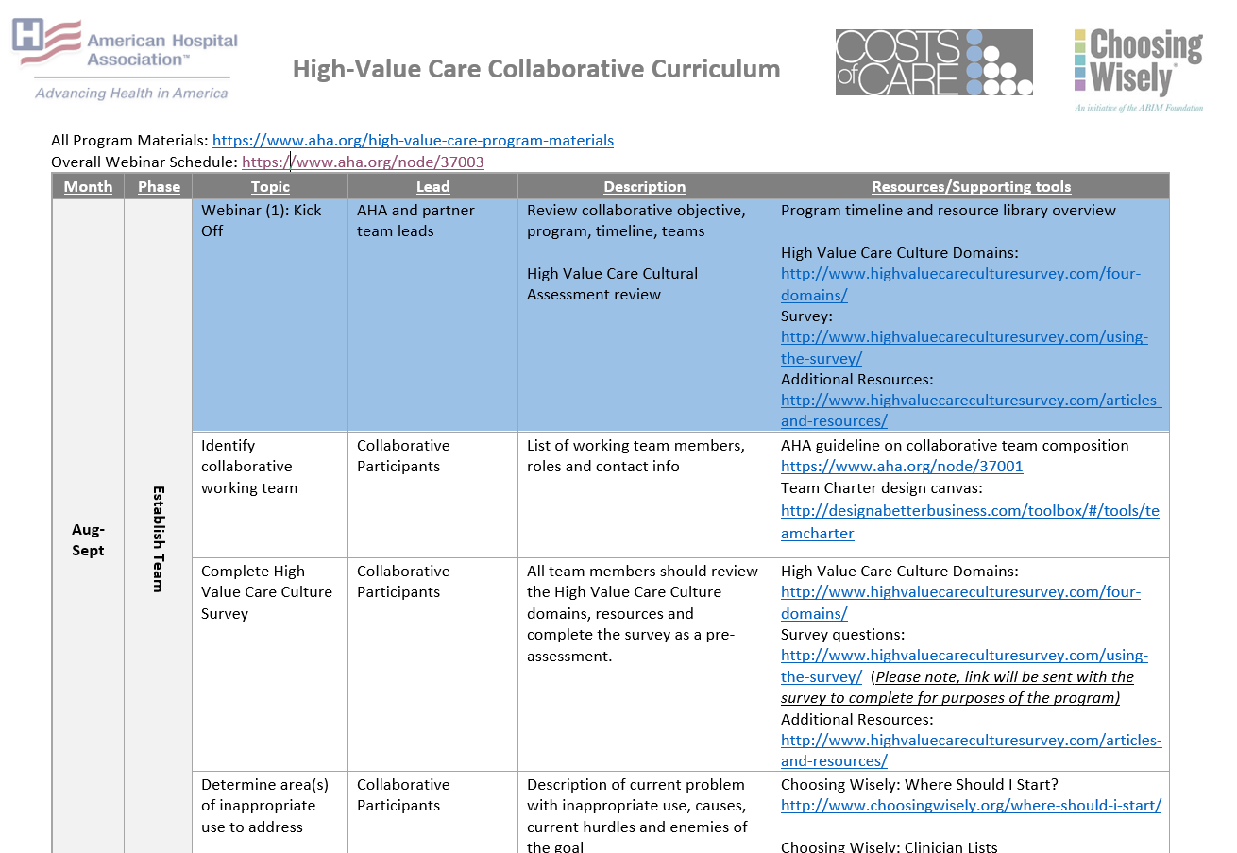
Curriculum

Slide 6
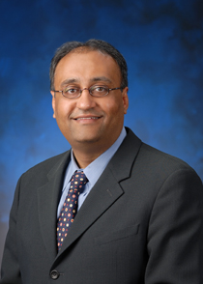
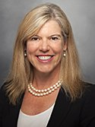



Mentors
Alpesh Amin, MD
Professor & Chair of Medicine and Executive Director, Hospitalist Program, University of California, Irvine
Amy Compton-Phillips, MD
EVP & Chief Clinical Officer, Providence Health & Services
Reshma Gupta, MD
Medical Director for Quality and Value & Assistant Professor, Division of General Internal Medicine & Health Services Research, UCLA Health
Outreach and Evaluation Director, Director of Teaching Value in Healthcare Learning Network, Costs of Care
Sunny Jha, MD
Clinical Assistant Professor of Anesthesiology
Keck School of Medicine, University of Southern California
Chris Moriates, MD
Associate Professor, Department of Internal Medicine
Assistant Dean for Healthcare Value
Department of Medical Education
Dell Medical School
The University of Texas at Austin
Notes:
Who they are,
Matching is coming and call scheduling outreach

Slide 7


Neel Shah, MD, MPP
Founder and Executive Director, Costs of Care
Assistant Professor of Obstetrics, Gynecology and Reproductive Biology
Harvard Medical School
Director, Delivery Decisions Initiative, Ariadne Labs

Slide 8
American Hospital Association
High Value Care Collaborative Opening Webinar
August 6, 2018

Slide 9


Choosing Wisely is an initiative of the ABIM Foundation to help clinicians and patients engage in conversations about the overuse of tests and procedures and to support physician efforts to help patients make smart, effective choices.
Notes:
So what do we do about this? How do we challenge “the norm” that is U.S. health care spending and system operations?
Our answer is the Choosing Wisely campaign.
Choosing Wisely is all about physicians and patients talking about what care is really needed and avoiding care whose harm may outweigh the benefits.
Choosing Wisely is about leading a national conversation about the right thing at the right time for the right patient – and avoiding unnecessary care.
While Choosing Wisely is about utilizing the most appropriate tests and treatments to avoid harm and keep patients safe, a byproduct of this effort is fewer patients receiving unneeded care and will result in fewer dollars spent on health care.

Slide 10


The Guide Star of Professionalism
3 Fundamental Principles
Primacy of patient welfare
Patient autonomy
Social justice
10 Commitments
Professional competence
Honesty, confidentiality and appropriate patient relations
Improving quality of care
Improving access to care
Just distribution of resources
Scientific knowledge
Avoiding conflict of interest
Professional code of conduct
Notes:
Before we jump into details about the campaign, let’s first talk about how the idea of this campaign originated.
It all starts with the Physician Charter.
In 2002, the ABIM Foundation, American College of Physicians Foundation and the European Federation of Internal Medicine jointly authored Medical Professionalism in the New Millennium: A Physician Charter.
The Charter states that physicians have a professional obligation to commit to a just distribution of finite resources – and that unnecessary services not only expose patients to harm and expense, but diminish the resources available for others.
Fundamental Principles
Primacy of patient welfare
Patient autonomy
Social justice
A Commitment to
Professional competence
Honesty with patients
Patient confidentiality
Maintaining appropriate relations with patients
Improving quality of care
Improving access to care
A just distribution of finite resources
Scientific knowledge
Maintaining trust by managing conflicts of interest
Professional responsibilities

Slide 11
Lessons Learned
Power of messaging and framing
Simple rules
Engagement and partnership
Bottom-up approach with support
Need for system and performance improvement approaches

Slide 12
Multi-Component Intervention
Identify targeted recommendations & clinicians
Identify metric to be used
Education on recommendations & clinical pathways
Peer-to-peer comparison/ academic detailing
Clinical decision support & order sets
Align rewards, financial & non-financial
Prepare patient – materials in exam room, waiting room

Slide 13
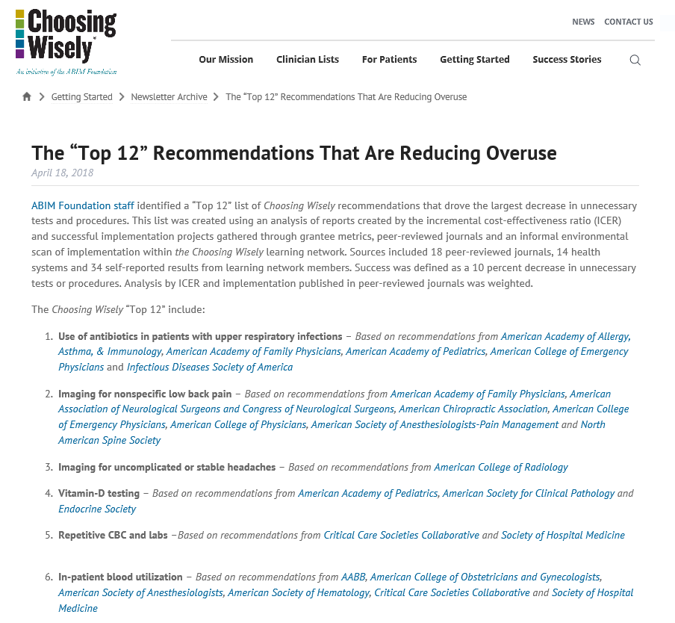
Notes:
GENESIS -- With funding from a Putting Charter into Practice grant, the National Physicians Alliance created a set of three lists of specific steps physicians in internal medicine, family medicine and pediatrics could take in their practices to promote the more effective use of health care resources.
At around the same time, physician Howard Brody called on medical specialty societies, as stewards of finite health care resources, to identify five areas of waste in their respective field
Thus, the concept of Choosing Wisely was conceived.
Medicine’s Ethical Responsibility for Healthcare Reform – The Top 5 List
Howard Brody, MD PhD
The “Top 5” Lists in Primary Care
Meeting the Responsibility of Professionalism
The Good Stewardship Working Group

Slide 14
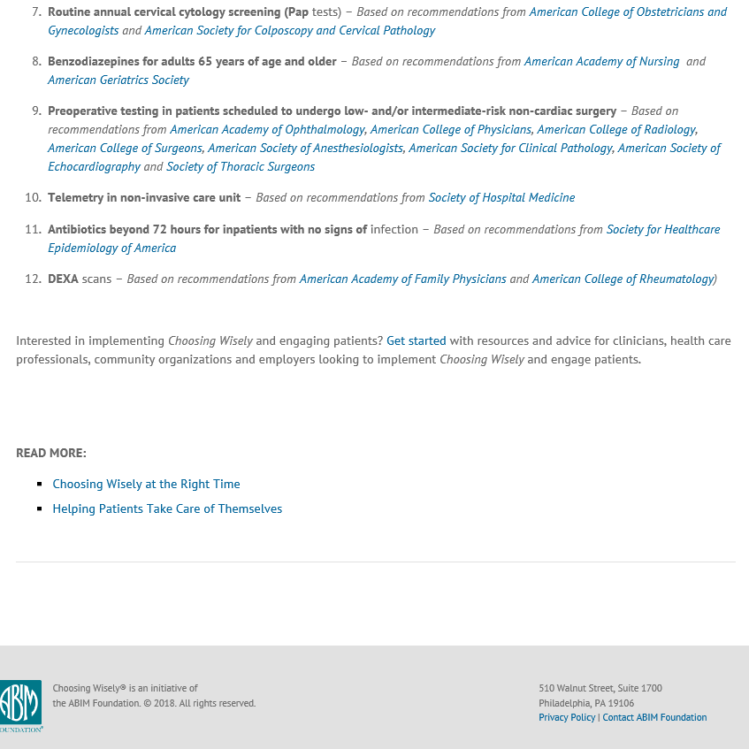
April 4, 2012
Notes:
We launched the campaign on April 4, 2012 with nine brave medical societies publishing the first 45 Choosing Wisely recommendations.
We kicked things off with a press conference at the National Press Club in Washington DC – the announcement generated widespread media attention including the front page of the New York Times, Washington Post, USA Today, and stories on the nightly news of ABC, CBS and NBC.

Slide 15
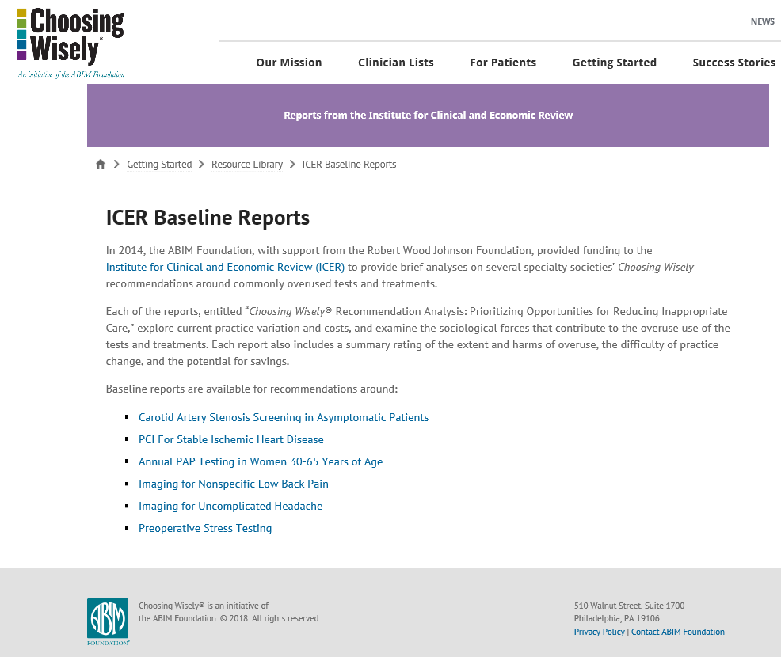

Slide 16
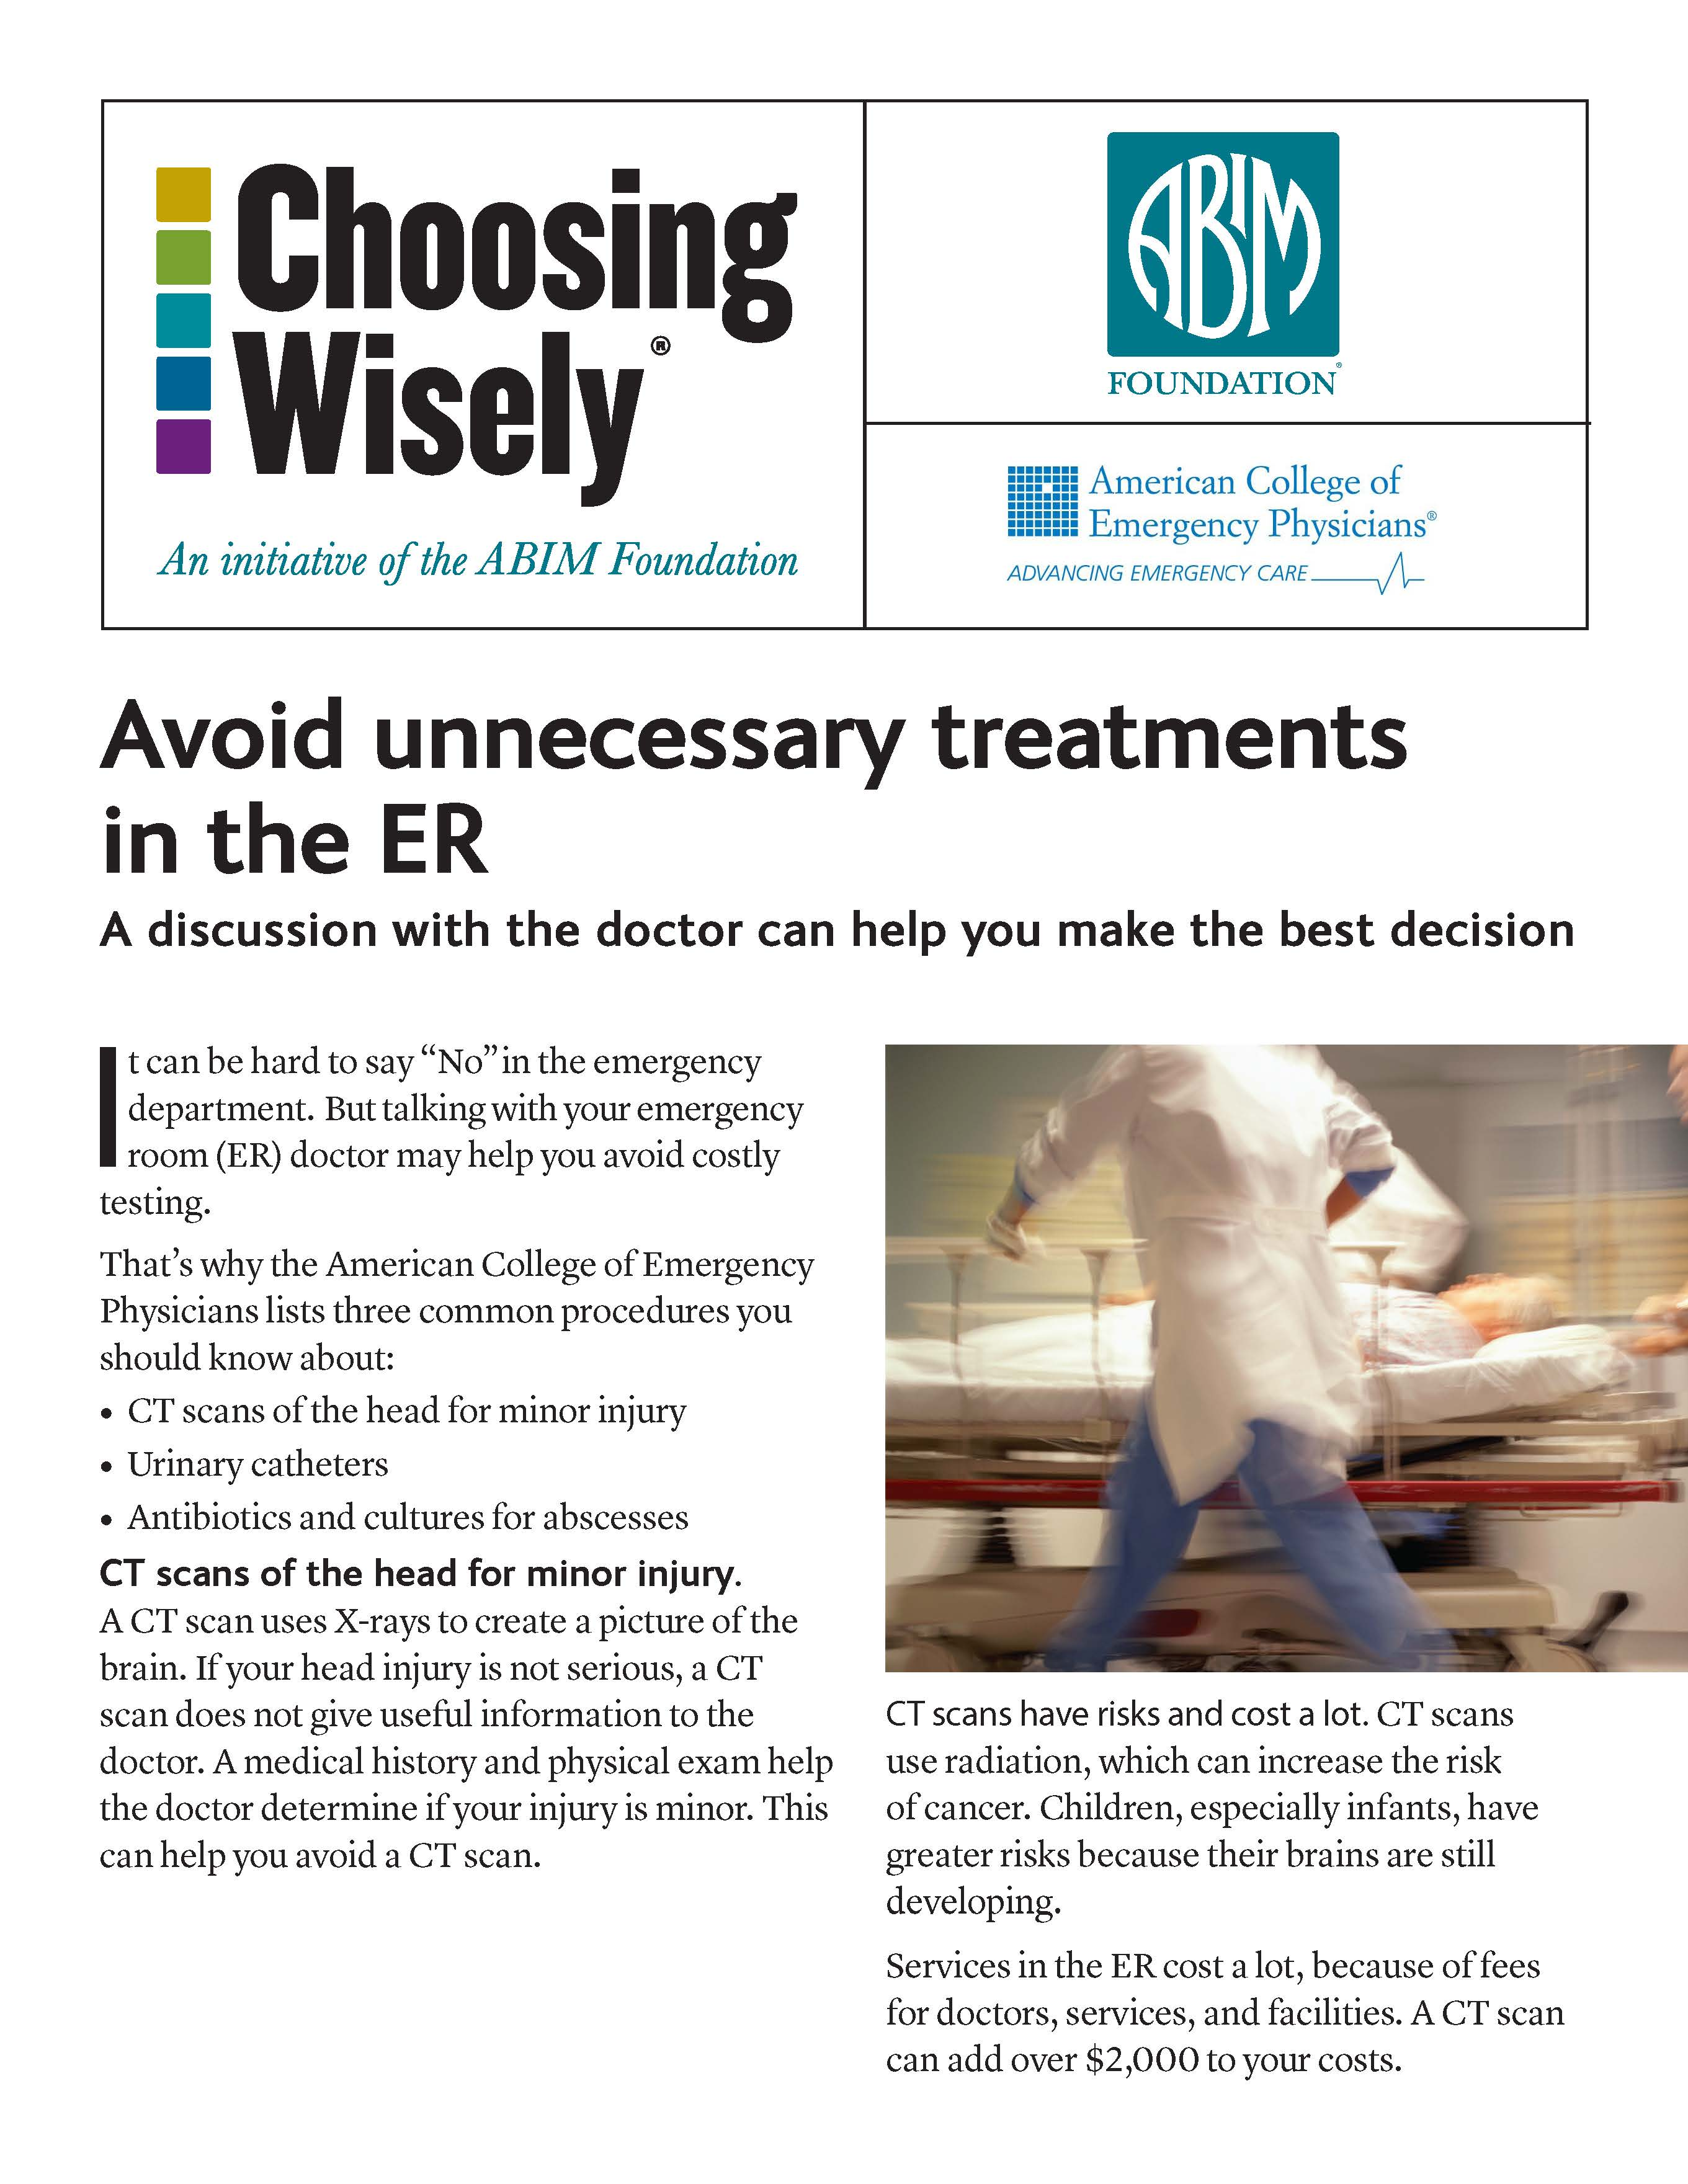
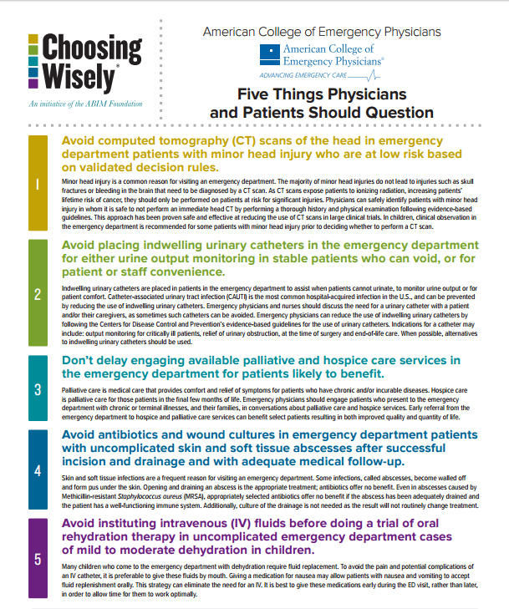
Clinical Recommendations
Consumer Translation
Notes:
Consumer Reports plays an important role as a partner in the campaign by working with medical specialty societies to translate their lists into patient-friendly language. To date they’ve published more than 100 Choosing Wisely brochures for patients.

Slide 17



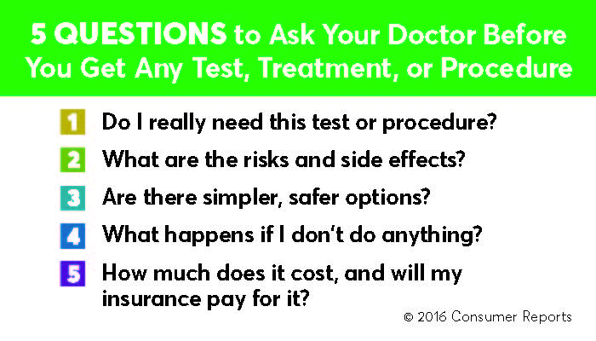
Patient Brochures
Wallet Cards
Mobile App
Notes:
Tremendous progress to date
80 specialty society partners
535+ recommendations
29 current and former grantees
45+ Choosing Wisely Champions
70+ consumer and employer groups
1,330 journal articles referencing Choosing Wisely in 2016, based on Google Scholar search for the term “Choosing Wisely” and the word health
19 other countries (Europe, South and East Asia, Australia/NZ, Israel, Canada, Brazil)

Slide 18

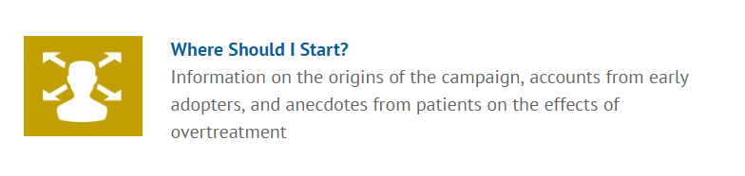



Choosing Wisely Website
www.ChoosingWisely.org/Resources
Tools for clinicians

Slide 19
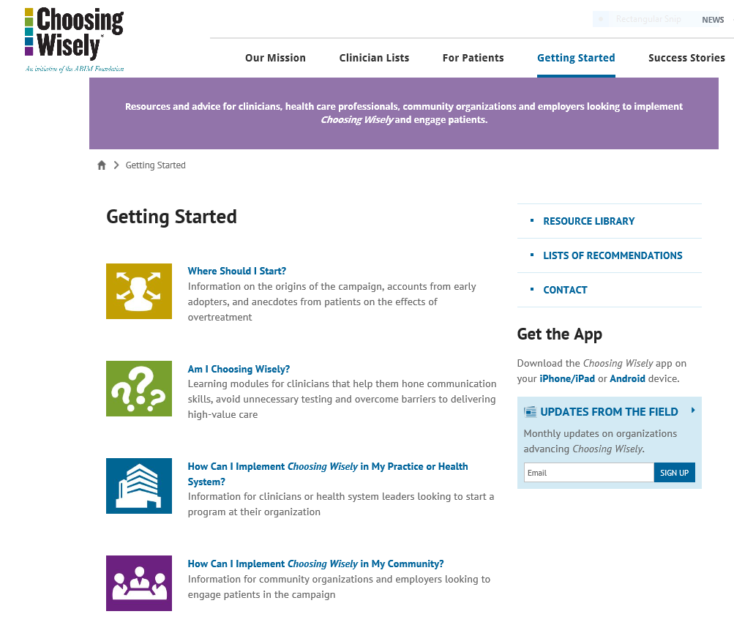

Slide 20
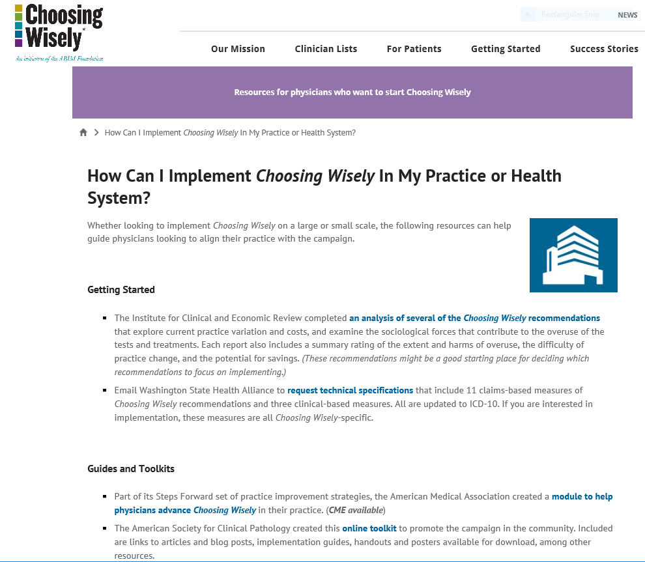
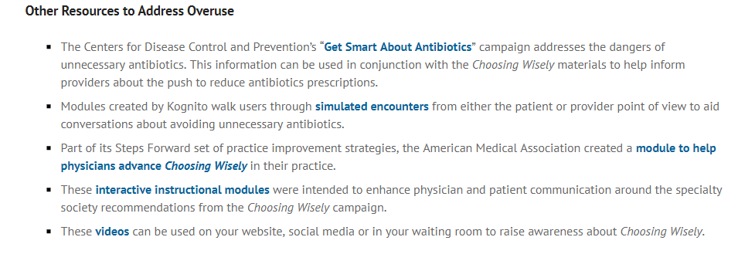
Interactive instructional modules
Notes:
Detail of where to find interactive instructional modules on this page – under Other Resources heading

Slide 21
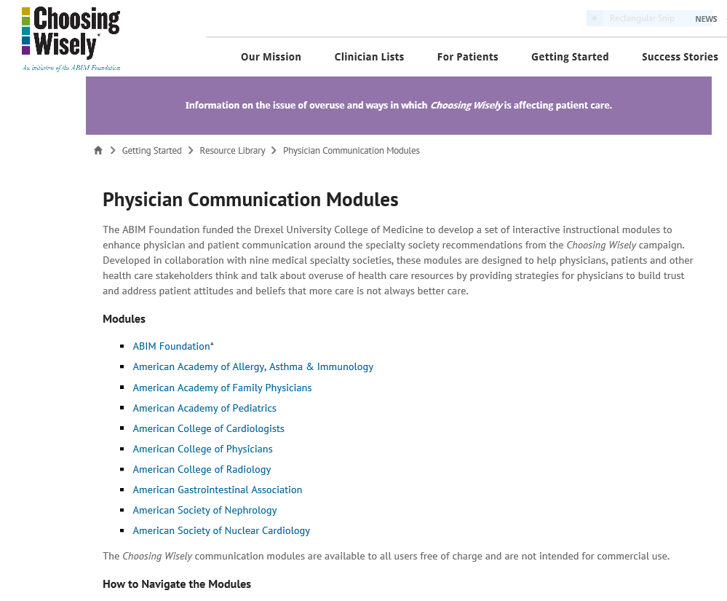

Slide 22
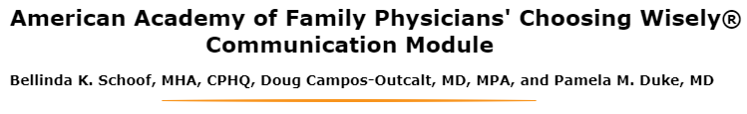
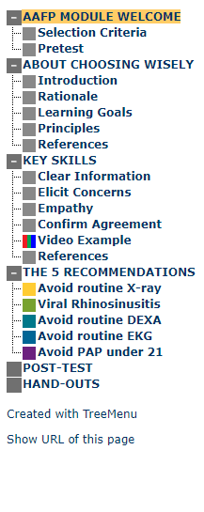
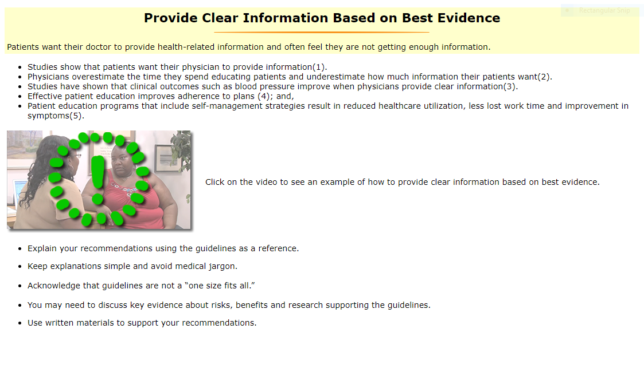
Interactive Instruction Modules
Notes:
Video simulates a conversation between clinician and patient who suffers from headaches and wants imaging study of her head

Slide 23
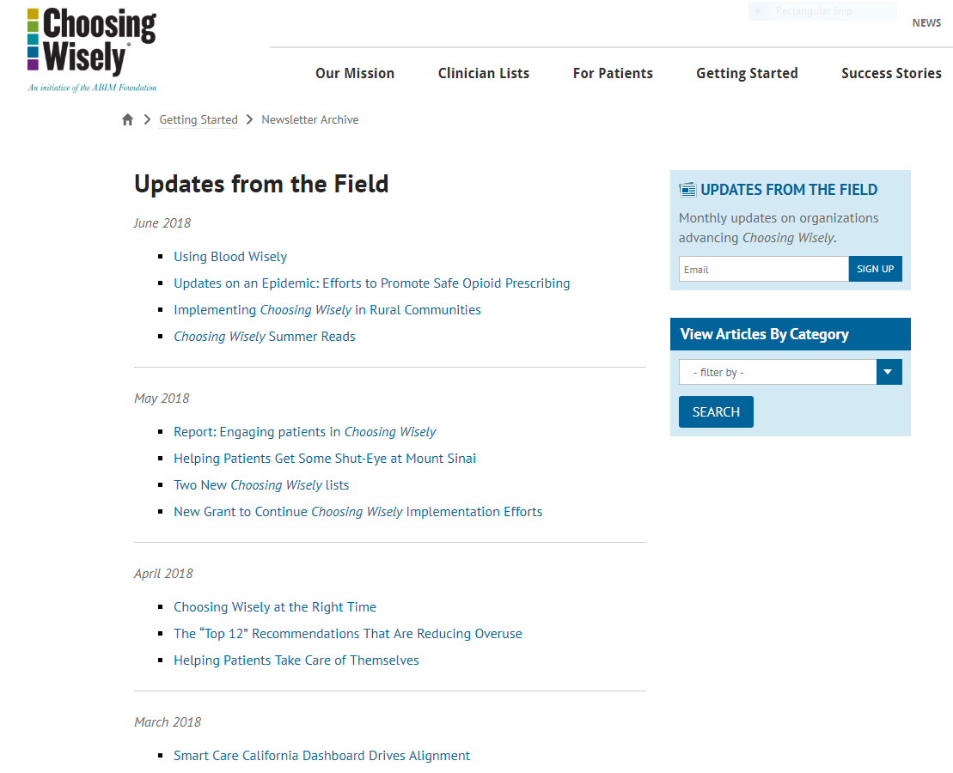
Monthly
E-newsletter
Notes:
Subscriber box in right sidebar column

Slide 24

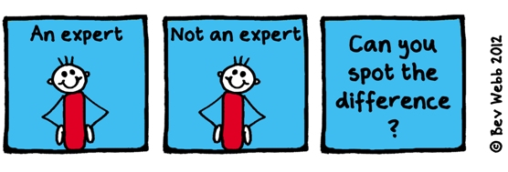


Learning Networks and Communities
Resource Emails
Health System Leaders – Tim Lynch, Senior Director of Programs, at tlynch@abim.org
Choosing Wisely Learning Network – Kelly Rand, Program Manager, at krand@abim.org
Notes:
Bi-monthly webinar series highlighting the work of past and current grantees who are implementing the campaign in their community or system;
expert guests sharing best practices for reducing overuse
access to a shared virtual space
monthly resource email and the Choosing Wisely Connect email
Health system leaders -- The network offers a monthly resource email and quarterly webinars.
Choosing Wisely learning network – sharing of implementation efforts, outcomes among grantees and others

Slide 25




Learning and Research Communities
Teaching Value in Health Care/
Costs of Care – Reshma Gupta at r44gupta@ucla.edu
Research Community on Low-Value Care – Rosina Pradhananga at Rosina.Pradhananga@AcademyHealth.org
Notes:
Bi-monthly webinar series highlighting the work of past and current grantees who are implementing the campaign in their community or system;
expert guests sharing best practices for reducing overuse
access to a shared virtual space
monthly resource email and the Choosing Wisely Connect email
Health system leaders -- The network offers a monthly resource email and quarterly webinars.
Choosing Wisely learning network – sharing of implementation efforts, outcomes among grantees and others

Slide 26


System and Performance Improvement
Programmed 180 Choosing Wisely recommendations into EHR
Alerted physicians who attempted to order test or treatment referenced by Choosing Wisely
Links to society recommendation and Consumer Reports materials
$6 million in annual cost savings in aggregate from implementing Choosing Wisely recommendations across system
Scott Weingarten, MD
Senior Vice President
Chief Clinical Transformation Officer
Notes:
One of the independent leaders in CW campaign – introducing system level implementation through electronic medical records
Programmed 100 CW recommendations into EMR system in both inpatient and ambulatory settings
Recs related to ordering rates for blood transfusions for patients with high hemoglobin levels, vitamin D tests, testosterone treatments, HPV tests and appetite stimulants – all decreased by at least 20%
Soft stops and medium stops that require clinicians to provide rationale for overriding alerts

Slide 27
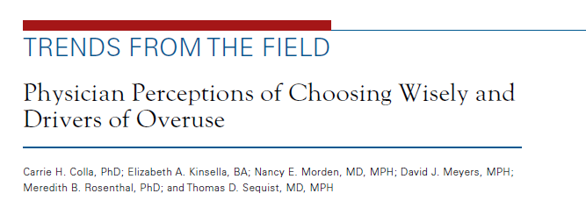
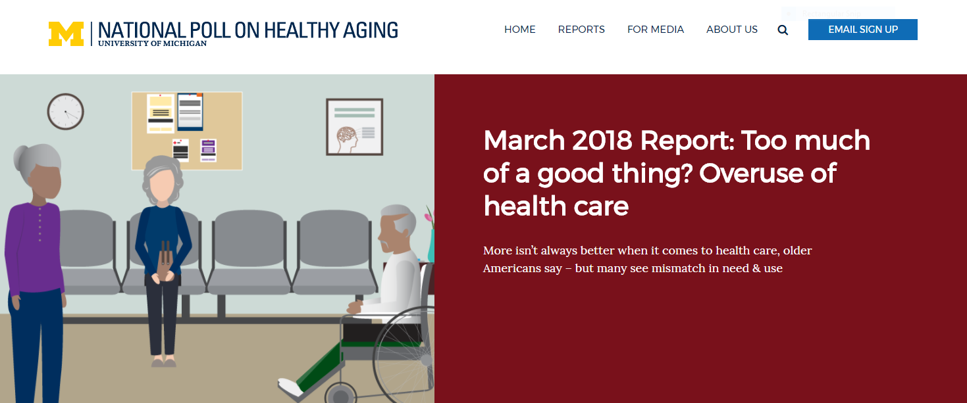
Evidence of Cultural Change
From why didn’t you order that test to why did you order that test?
From thoroughness to appropriateness
Notes:
Show Physician Perceptions of CW and Drivers of Overuse. 75% of primary care physicians at the largest ambulatory care provider in Massachusetts – reported they agreed or somewhat agreed that CW empowered them to reduce use of unnecessary tests and procedures. University of Michigan – only 14% of people over 50 believe the more care is better when it comes to health care. Implications – improve communication about the mismatch of opinions.

Slide 28


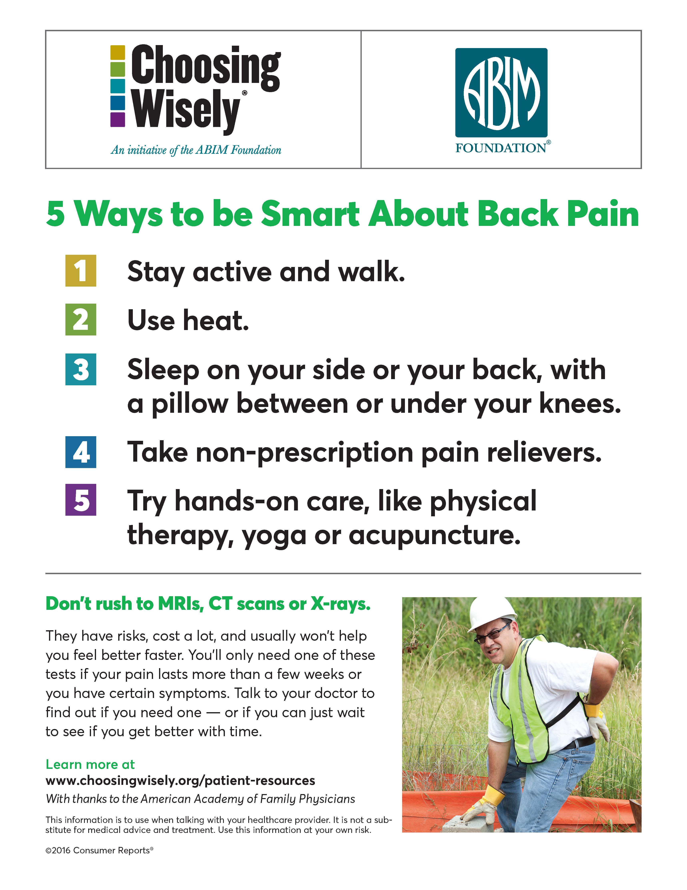



Reduction in Lab Work, Imaging
Interventions
Clinical decision support
Comparative performance feedback
Best practice alerts
Patient education materials
Physician champions
Results
Henry Ford
  57% decrease in Vitamin D tests
  27% decrease in imaging for low back pain
Detroit Medical Center
  33% drop in Vitamin D tests
Notes:
33% reduction in Vitamin D tests, from 5.44 rate per day to 3.66 rate per day – Detroit Medical Center-PHO
57% reduction in Vitamin D tests, from 195 rate per day to 83.5 rate per day – Henry Ford
One outlier – 97% decrease in lower back imaging – Henry Ford

Slide 29



Reduction in Pre-Op Screenings
Interventions
Established new guidelines for pre-cataract surgery
Changed workflows, surgery requirements
Physician champions
Clinical education
Results
37% drop in chest X-rays
83% decrease in EKG testing
87% decrease in lab tests
VALUE Added
6 more mos. of improved vision
Notes:
In spring 2015, the ABIM Foundation—with continued funding from the Robert Wood Johnson Foundation —awarded grants to support seven initiatives focused on reducing utilization of inappropriate tests and treatments. Each initiative includes delivery systems, hospitals and/or medical groups collaborating with multi-stakeholder community-based groups and physician-led organizations.
UCLA/LA DHS
• Los Angeles County Department of Health Services’ showed the following reductions in pre-op testing:
o 37% reduction in chest X-rays before surgery;
o 83% reduction in EKGs before surgery ; and
o 87% reduction in labs before surgery.
Added Value: access to operation six months earlier equals six more months of improved vision for patients; historically marginalized population
• LA DHS process for improvement included using the Balance Scorecard; A champion resident physician and department chairs emailing all ophthalmology and anesthesiology physicians NEW Guidelines and changing cataract surgery requirements and workflow
For antibiotics reductions the LA DHS used behavioral economics incorporating affirmation posters to provide clinicians and patients with a “nudge”
• LA DHS is the second largest health system in the country, and the largest “safety net” health system serving vulnerable populations (90% percent at or below the federal poverty level)

Slide 30

@ABIMFoundation #choosingwisely

Slide 31
Creating a High-value Care Culture
Understand how to Measure and Target Improvements
Reshma Gupta, MD, MSHPM
UCLA Health, Medical Director for Quality and Value
Costs of Care, Outreach and Evaluation Director, Director of Teaching Value in Healthcare Learning Network
Assistant Professor, Division of General Internal Medicine & Health Services Research, UCLA
Twitter: @ReshmaGuptaMD

Slide 32




The book is a masterful primer for all clinicians—especially those of us hoping to navigate the transition from volume-based healthcare to value-based healthcare without running aground.
Atul Gawande, MD
Professor of Surgery, Harvard Medical School, author of Being Mortal and The Checklist Manifesto
This book is an instant classic. It masterfully summarizes and makes accessible a mountain of relevant health care delivery research. And it gives front-line clinicians and other health care leaders a raft of practical ideas to help make care dramatically safer, more patient-focused, and more affordable."
Donald Berwick, MD
President Emeritus and Senior Fellow, Institute for Healthcare Improvement
Partners

Slide 33
Objectives
Discuss the role of culture in creating a high-value care environment
Discuss the High-value Care Culture Survey
  Purpose
  Development
  Approach to understand results
© Copyright 2017 All Rights Reserved. Costs of Care.

Slide 34
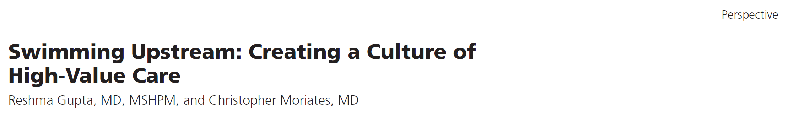

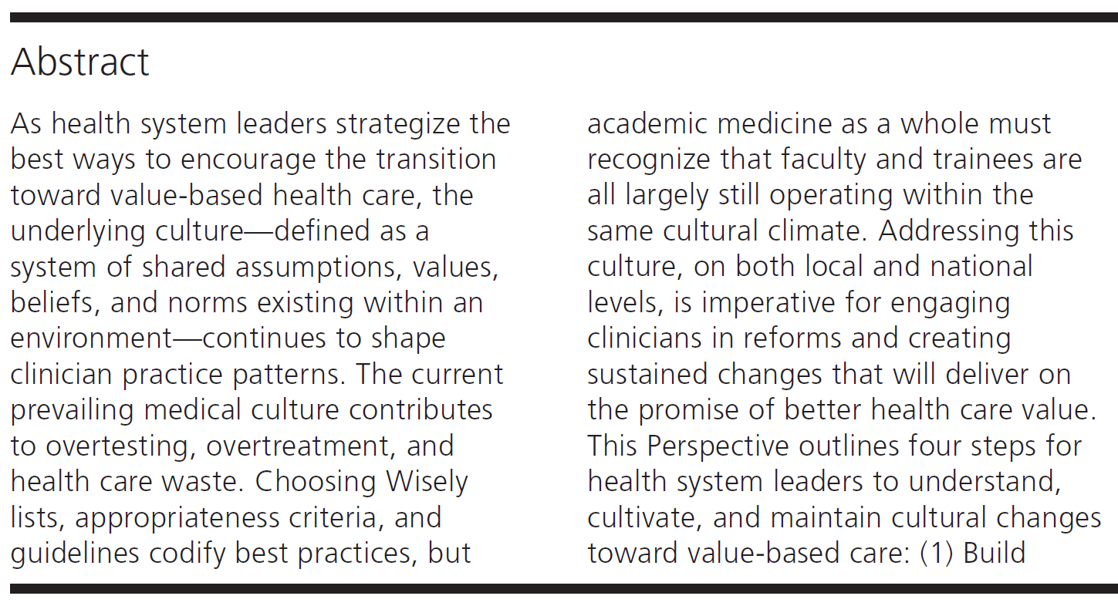
    If healthcare practitioners are fish, high value care culture is the water we swim in.
Culture is the Water We Swim In and
Takes Time to Change
Academic Medicine, November 26, 2016
“
(Gupta, Moriates. “Swimming Upstream: Creating a Culture of High-value Care.” Acad Med. 2016.)
(Ravasi, Shultz. “Responding to organizational identity threats: Exploring the role of organizational culture.” Acad Manag J. 2006.)

Slide 35
Culture is Associated with Overuse and Clinical Outcomes
97% of emergency medicine physicians reported unnecessary imaging testing. Authors believe reflects a cultural response to uncertainty.
Institutional culture and policies are associated with medical trainees feeling compelled to offer the choice of resuscitation in all clinical situations regardless of whether they believed it was clinically appropriate.
Systematic review found consistent association between positive organizational culture and outcomes including mortality.
Higher patient safety culture survey scores are associated with clinical behaviors and improved patient outcomes across health systems
(Kanzaria HK. Acad Emerg Med 2015.)
(Dzeng E. JAMA Intern Med 2015.)
(Braithwaite J. BMJ Open. 2017.)
(Singer S. Health Serv Res. 2009.)
(Berry JC. J Patient Saf 2016.)

Slide 36

Hidden Curriculum = part of culture
Imbalanced focus on identifying rare cases
Sins of omission > sins of commission
Misperception that considering cost is not aligned with patient interests
© Copyright 2017 All Rights Reserved. Costs of Care.

Slide 37

Organizations and Addressing Culture
“Organizations will generally try to create needed change without addressing, budgeting for, or having the patience for culture change.
God bless them if they are successful.
The vast majority won’t be.
Leaders cannot create culture, but they MUST create the conditions for a great one to emerge.”
Robert Wachter, 2016.
© Copyright 2017 All Rights Reserved. Costs of Care.

Slide 38
Objectives
Discuss the role of culture in creating a high-value care environment
Discuss the High-value Care Culture Survey
  Purpose
  Development
  Approach to understand results
© Copyright 2017 All Rights Reserved. Costs of Care.

Slide 39
Developing a High Value Care Culture Survey (HVCCSTM)
Patient safety culture surveys are widely used in hospitals for benchmarking and identifying areas of improvement. No such tool exists for HVCC.
Methods:
1. Create a High Value Care
Culture Conceptual Model
Physician
Characteristics
Physician’s Prediction of Cost and Quality Outcomes to Patient and Health System
Value-based Clinical Decision Making
Organizational
Culture
Patient
Characteristics
National Guidelines & Regulations
Organizational
Structural
“
2. Develop Survey Items: Modified Delphi Process (nationally representative key stakeholders, n=28)
3. Survey Administration:
Center A
81 residents, 47 hospitalists
Response rates %(N): Residents: 98% (79)
Hospitalists: 83% (39)
Center B
81 residents, 44 hospitalists
Response rates %(N): Residents: 77% (62)
Hospitalists: 77% (34)

Slide 40

www.highvaluecareculturesurvey.com

Slide 41
Culture Survey Findings
High-Value Care Culture Survey
(HVCCS™, www.highvaluecareculturesurvey.com)
Scores differed consistently across the two pilot centers. (Center B had higher HVCCS scores overall and in 3 of 4 domains tested).
HVCCS positively correlated with institution’s CMS Value-Based Purchasing scores.
“
(Gupta R, Moriates C, Harrison JD, et al. BMJ Qual & Saf. 2016)

Slide 42
Culture Survey Conclusions and Next Steps
Conclusions:
Health system leaders and program directors can use this survey to identify target areas for improvements and monitor the effects of high value care initiatives.
Provides initial support for reliability and validity of the HVCCS.
12 Site Follow-up Study:
Medicine residents and hospitalists completed the HVCCS across 4 university, 4 community, 4 county centers. HVCCS and Value-based Purchasing scores correlated.
“
Medical Center Type | Spearman Rank Correlation (r) | P-value
Community and University Medical Centers | 0.71 | 0.047
Value-based purchasing scores do not adjust for patient sociodemographic factors. Further evaluation is needed among county medical centers.
(Gupta R. “The Association of Hospitalist Productivity Payments and High-Value Care Culture.” Acad Med. 2018.)
(Gupta R. “High-Value Care Culture among the Future Physician Workforce.“ 2018.)

Slide 43
Leadership and Health System Messaging
Consists of 17 questions.
Covers engagement with frontline clinicians, leadership visibility and support, high quality communication about quality and safety of care, role modeling, and pride and formal training in value-based care.
Low scores among individual questions in this factor can identify areas for improvement.
It will be important to review the specific questions for which your clinicians report lower scores and identify with your team and coach where there are opportunities to improve.

Slide 44
Example) Supervisors in my group review my performance based on decisions that lead to delivering quality care at lower cost…
More than half of clinicians disagree that supervisors review value performance.
Data on value performance could be provided to supervisors, and expectations could be established to incorporate this into routine evaluations.
%

Slide 45
Example) My group is actively implementing projects that address costs of care…
Nearly 45% of clinicians disagree that their group is actively implementing projects.
Leadership could develop systems to encourage initiatives including financial or non-financial incentives, competitions, and resource support.
%

Slide 46
Example) My group openly discusses ways to deliver quality care at lower cost within my group…
Only 37% of clinicians agree that their groups have open discussions.
Leaders could create time in meetings and evaluations to discuss methods and concerns to improve high value performance.
%

Slide 47
Example) My group has formal training to address healthcare value…
46% of clinicians disagree that their groups have formal training.
Leaders could create protected time and suggest resources to clinicians to gain skills in high-value decision making.
%

Slide 48
Data Access and Transparency
Consists of two questions.
This second factor focuses on the availability of cost data for frontline clinicians.
Questions: (Disagree to Agree Scale)
Clinicians in my group have access to information about the costs of tests and procedures they order or provide
When clinicians in my group have questions about costs, they know where to go to find answers.

Slide 49
Example) When clinicians in my group have questions about costs, they know where to go to find answers…
There is agreement about lack of access to cost information.
Centers with lower scores in this domain may need to prioritize creating reliable cost databases and providing this data to clinicians.
%

Slide 50
Comfort with Cost Conversations
Consists of three questions.
This factor covers comfort of clinicians to have conversations about costs of care with patients.
Recent studies show that patients are worked about healthcare costs and want to talk about costs with their physicians.
Questions: (Disagree to Agree Scale)
Patients that I see are uncomfortable discussing costs of tests or treatments
Clinicians in my group are uncomfortable discussing costs of tests or treatments with patients
Clinicians in my group feel that it is not the role of physicians to discuss costs of tests or treatments with patients

Slide 51
Example) Clinicians in my group are uncomfortable discussing costs of tests or treatments with patients…
There is great variability in responses with only 1/3 who disagree.
Consider training clinicians to have discussions about the costs of their care with patients.
%

Slide 52
Blame-free Environment
Consists of two questions.
Focuses on a sense of individual blame within divisions, practice groups and training programs.
Questions: (Disagree to Agree Scale)
In my group, clinicians’ fear of legal repercussions affects how often they order unneeded tests or procedures
Individual clinicians get blamed for medical or surgical complications

Slide 53
Example) In my group, clinicians’ fear of legal repercussions affects how often they order unneeded tests or procedures…
Nearly 50% of clinicians agree.
Consider focusing on promoting evidence-based practice and giving clinicians information to fairly weight the risks and benefits of defensive medicine.
Consider creating a non-punative environment with system leaders.
%

Slide 54
Approaching Data
There are no goal benchmarks for metrics at this time, though we can use this survey to compare to other hospital groups. We recommend instead for you as a group to use the results to identify potential areas for improvement and to monitor/measure for success.
These are complex issues and improvement may require additional infrastructure. We do not expect to get to 100% for each metric.
We suggest working closely with your coaches to plan out when and how to administer surveys to obtain high response rates (e.g. required meetings, using on-line formats to email). We suggest administering at baseline and at 6 or 12 month time points.
Coaches can also help reflect on areas of opportunity.

Slide 55
We hope the HVCCSTM will help you begin improving culture at your institutions!

Slide 56

Elisa Arespacochaga
Vice President, AHA Physician Alliance
312-422-3329
elisa@aha.org

